Slide 1
FHIR-Based Prior Authorization Workflows
Differences from Historical Approaches
Robert Dieterle HL7 Da Vinci Project Sr. Advisor and Burden Reduction Lead, and CEO, EnableCare Group

Slide 2
Agenda
Overview of HIPAA PA workflow
Goals of PA workflow changes
Overview of CRD/DTR/PAS/CDex workflow
Implications of workflow changes
Key messages

Slide 3
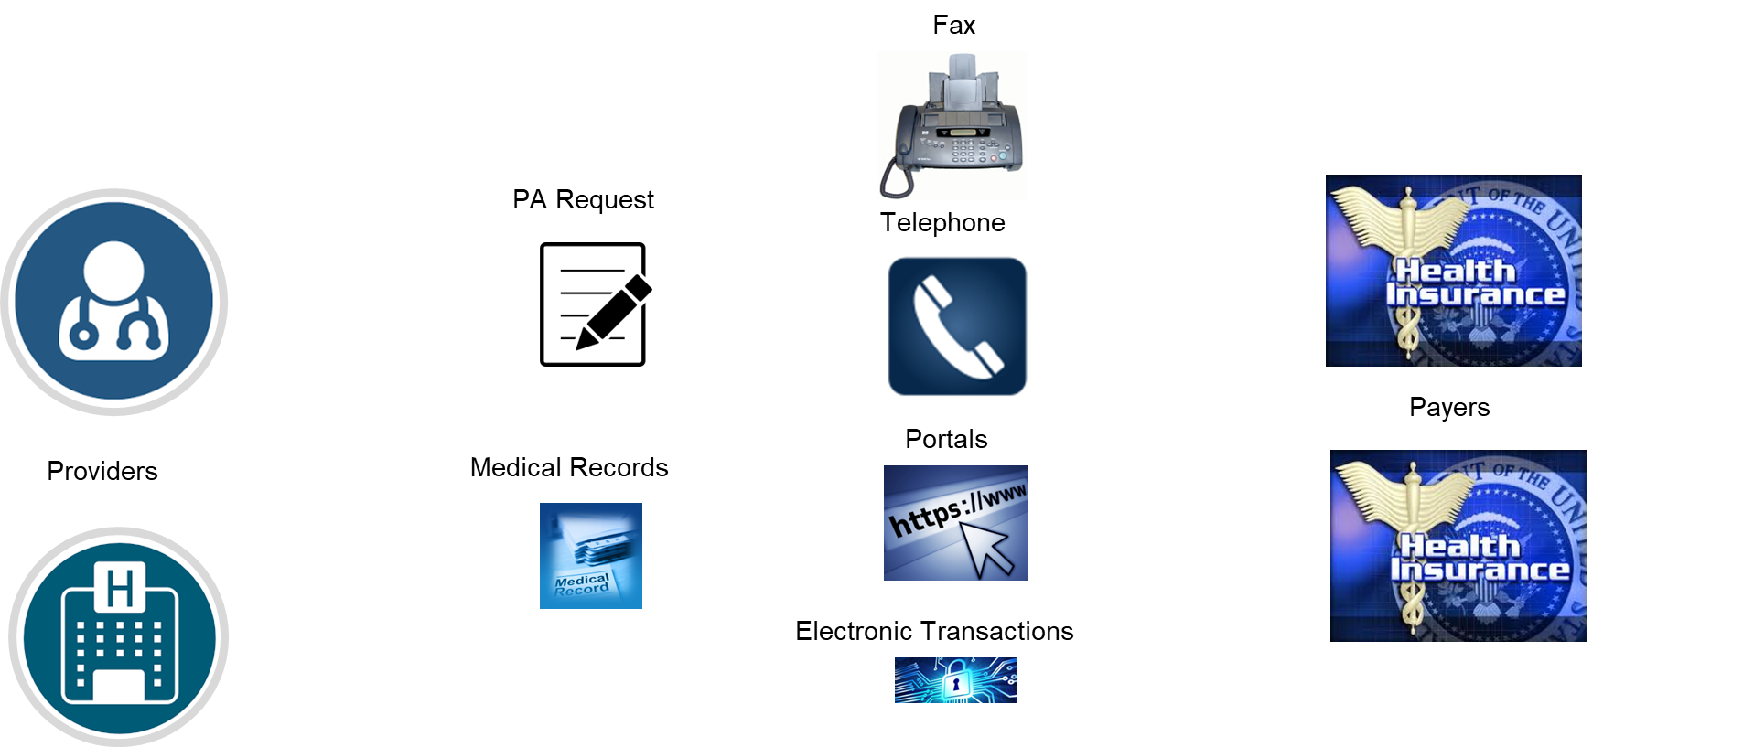
Components of HIPAA PA Exchanges

Slide 4




HIPAA Regulatory Requirements
Must be X12 278 (PA request)
May be any method (including X12)
Any Method
1
X12N278
Payer 1
Any Method
2
BA
X12 278
Payer 2
Covered entity may use a Business Associate (BA) to satisfy HIPAA requirements
HIPAA requirements pass to the BA

Slide 5

Challenge
Must be X12 278 (PA request)
May be any method (including X12)
Any Method
EHR
1
Any Method
X12 278
Payer 1
Any Method
2
Any Method
Pat Adm/
Practice
Mgmt./ BA
Payer 2
Pat Adm/
Practice
Mgmt./
Only 26% of PA and < 11% of attachments (with structured documents) are fully electronic using X12N standards (based on 2021 CAQH INDEX Report)

Slide 6

FHIR Enabled HIPAA Compliant Solution
Must be X12 278 (PA request/response)
May be any method
HL7 FHIR
FHIR
FHIR
X12 278
X12 278
1a
1b
Any Method
X12 278
Payer 1
FHIR
2
Any Method
FHIR
X12N278 or portal for DDE
FHIR
Payer 2
Note: Clearing House can be any intermediary with BAA
Note: supporting documentation may be exchange by any method (including X12 275)
6

Slide 7



FHIR Supported Prior-Authorization Environment
Must be X12 278 (PA request/response)
HL7 FHIR
Payer 1
FHIR
API
X12 278
FHIR
API
FHIR
API
FHIR
FHIR
BA
FHIR
API
Payer 2
FHIR
X12 278
FHIR
API
Treating Payer and any BA (including a clearinghouse) as a “black” box

Slide 8
Supporting X12 and FHIR based solutions for Prior Authorization
X12 278
Any Method
X12 278
Any Method
FHIR
Xl12 278/278I
Any Method
Payer
FHIR based HIPAA Exception
X12 278
Any Method
May use the X12 standard, or other methods to “connect” to provider and payers (portals may be supported )
FHIR
FHIR bundle containing the PA request and clinical documentation, inquiry, or the PA response
Mapping from FHIR bundle to/from X12 278 and exchange of FHIR bundle (optionally via X12 275 binary segment)
Note: the first three methods are fully HIPAA compliant, the FHIR end-to-end requires a HIPAA exception to test
8

Slide 9
Traditional Prior Authorization Workflow
Transaction based
Submit X12 278 request (may submit documentation)
Receive response with request for documentation
Submit requested documentation
Receive 278 response (Approve, Pend, Deny)
Knowledge of PA and documentation requirements vary by payer and need specialized knowledge to avoid unnecessary effort
Portal based
Login into payer specific portal
Indicate service / procedure
IF PA required, upload requested documentation
IF response is pended, need to check back on status
Portals and PA requirements vary by payer and need specialized knowledge and experience to avoid unnecessary effort

Slide 10
Goals of PA Workflow Changes
Improve patient care
Improve provider – patient decision making
Reduce provider burden
Documentation requirements highly focused
Reduce administrative cost
PA decision as early in clinical workflow as possible

Slide 11
Prior Authorization --- Burden Reduction
Coverage Requirements Discovery
Coverage Requirements Discovery
CDS Hooks
Documentation Templates and Rules
Documentation Templates and Rules
PROVIDER EHR/
BACK-OFFICE SYSTEMS
PAYER
FHIR APIs
Prior Authorization Support
Translation
X12 278 Request/Response
Transformation Layer
(Optional)
Prior Authorization Processing
FHIR Bundle /
Attachments
Clinical Data Exchange
FHIR APIs
Clinical Data Exchange
Improve Transparency
Reduce Effort for Prior Authorization
Leverage Available Clinical Content and Increase Automation

Slide 12
Prior Authorization --- Burden Reduction
Enforcement Discretion Impact
Coverage Requirements Discovery
Coverage Requirements Discovery
CDS Hooks
May return PA Number
Documentation Templates and Rules
Documentation Templates and Rules
PROVIDER EHR/
BACK-OFFICE SYSTEMS
FHIR APIs
PAYER
May return PA Number
Prior Authorization Support
FHIR Bundle /
Attachments
Prior Authorization Processing
Translation
X12 278 Request/Response
Transformation Layer
X12 278 not required
Clinical Data Exchange
FHIR APIs
Clinical Data Exchange
Changes in CMS-0057-F final rule:
National Standards Group issued Enforcement Discretion and will no longer require the use of X12 278 Request / Response if the Prior Authorization API is used
Improve Transparency
Reduce Effort for Prior Authorization
Leverage Available Clinical Content and Increase Automation

Slide 13
COVERAGE REQUIREMENTS DISCOVERY (CRD)
Invokes service and send pre-fetch FHIR data from patient’s record and order Information
CDS service searches repository of services
Purpose
Takes guesswork out of patient specific coverage by sharing authorization or process requirements in workflow
Improves transparency of patient and procedure specific rules to provider and patient
Exposes information about patient benefits when care team is most likely with or near patient, so options can be discussed and decided upon
Technology
Takes advantage of CDS Hooks to integrate provider workflow with Payer decision support.
Workflow
May be triggered at scheduling time, during the order process, on demand, or at the end of an encounter.
Requires (in general)
Information relevant to the patient, provider, insurance, encounter purpose, orders placed or under consideration.
Returns
Determination of need for prior authorization and points to documentation requirements with ability to link to DTR
May eliminate need for an authorization if payer determines available information satisfies authorization requirements
Provider orders service
Patient Records
PROVIDER EHR/
BACK-OFFICE SYSTEMS
Library of services, coverage rules/templates
PAYER
Request additional information
No PA Requirement
Sends CDS Hooks Response
Determination Resp
Evaluate Response
Needs Addl Doc
Launch DTR
CRD is triggered by workflow and queries patient’s payer to determine if PA is required (replaces providers’ need to determine PA requirements by payer)
If PA is required and
sufficient information is provided, Payer may indicate authorization is satisfied by returning a unique ID (Determination Response) that is the Prior Authorization Number
additional information is required, Payer provides link to specific questionnaires

Slide 14
DOCUMENTATION TEMPLATES AND RULES
CRD or Manual Launch
Load context
Retrieve Questionnaire and CQL from payer
Purpose
Automates the process of assembling clinical documentation to support a prior authorization request for a specific payer
Based on the payer’s rules regarding required documentation
Allows automatic population of the template from the patient’s record and only request missing documentation
Allows documentation to be captured during the patient encounter to minimize the delay associated with PA
Technology
Takes advantage of SDC Questionnaire and Clinical Quality language (CQL) to assemble documentation required to support a prior authorization request
Supports both traditional FHIR questionnaires and adaptive forms to navigate complex guidelines with minimal user interaction
Workflow
May be triggered from CRD, delayed, standalone, or via CDex
Requires (in general)
Information relevant to the patient, provider, insurance, encounter purpose, orders placed or under consideration.
Returns
A completed documentation template and reference to specific FHIR resources required to support the medical necessity of the service or item that is the target of the prior authorization request
Library of services, coverage rules / templates
Patient Records
Prepopulate Questionnaire from patient record
Questionnaire Management
PAYER
Provider/ Staff
Prompt for missing information and allow review
If Adaptive Form (return information and repeat)
Store resulting data
Launch PAS
DTR uses context of CRD (provider, patient, orders, ….) and retrieves template(s) and documentation rules from payer (no need to manually enter available information)
Retrieves information from patient’s medical record and prepopulates the template (eliminates duplicate entry)
Prompt for missing information and allow review (specific to the service/item requested)
Complex guidelines can be handled with adaptive forms that solicit (from the patient’s record or provider) relevant information based on prior answers. (dramatically reduces need for large amount of clinical information)
Option exists for Payer (using adaptive forms) to declare authorization requirements are satisfied as part of DTR
This process replaces the need to request, gather, and submit documentation

Slide 15
Prior Authorization Burden Reduction using X12 278
PAS takes the information from CRD and DTR and submits it to the payer. If result is pended due to manual review, the system is either notified when a change is made or automatically requests an update (no need to constantly check for completed PAs)
Prior Authorization Support
Translation
X12 278 Request/Response
Transformation Layer
(Optional)
Prior Authorization Processing
PROVIDER
PAYER
FHIR Bundle /
Attachments
Assemble PA request (FHIR bundle)
Information for the X12 278
Clinical documentation support
Send to Intermediary
Create and send the X12 278 request to payer
Encode and send the entire FHIR bundle using X12 275 or alternative exchange standard
Receive X12 278 and FHIR bundle
Decode FHIR bundle
Process X12 278 or FHIR bundle
Evaluate supporting clinical documentation
Receive the response
If pended, poll for response or wait for subscription alert
If complete, update patient record
Translate X12 278 Response to FHIR bundle
Return to provider
Generate X12 278 Response
Send to Intermediary

Slide 16
Prior Authorization Burden Reduction
Under Enforcement Discretion
PAS takes the information from CRD and DTR and submits it to the payer. If result is pended due to manual review, the system is either notified when a change is made or automatically requests an update (no need to constantly check for completed PAs)
FHIR Request Bundle / Attachments
Prior Authorization Support
Prior Authorization Processing
PROVIDER
PAYER
FHIR Response Bundle
PAYER
Assemble PA request (FHIR bundle)
Clinical documentation support
Send to Payer or Intermediary
Receive FHIR bundle
Decode FHIR bundle
Process FHIR bundle
Evaluate supporting clinical documentation
PROVIDER
Receive the response
If pended, wait for subscription alert
If complete, update patient record
Generate Response Bundle
Send to Provider or Intermediary

Slide 17
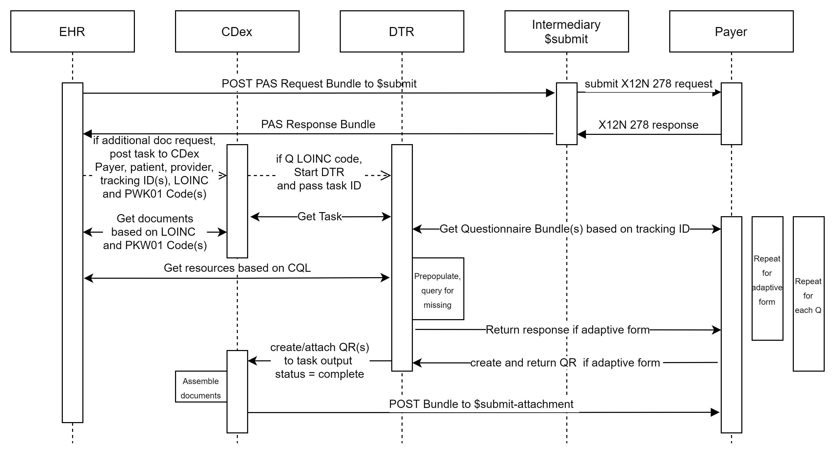
PAS Request for Additional Information Using CDex

Slide 18
Benefits from Burden Reduction Automation
Using CRD/DTR/PAS/CDex
Interoperability
Standardized interactions across all payers and providers
Provide real-time access to payer requirements for prior authorization and documentation
Provide ability to move to real-time authorizations
IGs leverage standard interfaces and technologies (e.g., CDS Hooks and SMART on FHIR) that will support in workflow integration, information sharing, and patient care benefits beyond prior authorization
Data shared is largely computable, maximizing automation and minimizing costs and time delays associated with human intervention
Workflow
Common workflow expectations
Support for clinical workflow activities to trigger interactions with payers enabling consideration of coverage and financial responsibility as part of clinical care
Enable work to be performed by the appropriate person
Save relevant PA request and response (e.g., authorization information) information (including clinical documentation) in the provider’s EHR
Privacy/Security
Comply with HIPAA requirements
Minimize the collection of documentation to that necessary for the specific service, rather than relying on generic collections of information that promote over-sharing such as a C-CDA
Improved privacy by only sharing data relevant to the specific prior authorization request
Burden Reduction
Avoid duplicate entry of information (e.g., into payer portals)
Automate the collection of documentation to support the need for a service that requires prior authorization
Adapts easily to new/changed information requirements (via FHIR API access) without development of new software capabilities
Notes:
Some of the key benefits from implementing CRD/DTR/PAS
Standardized interactions across all payers and providers
Provide real-time access to payer requirements for prior authorization and documentation
Support for clinical workflow activities to trigger interactions with payers enabling consideration of coverage and financial responsibility as part of clinical care
Enable work to be performed by the appropriate person
Save relevant PA request and response (e.g., authorization information) information (including clinical documentation) in the provider’s EHR
Minimize the collection of documentation to that necessary for the specific service,
Avoid duplicate entry of information (e.g., into payer portals)
Automate the collection of documentation to support the need for a service that requires prior authorization
Adapts easily to new/changed information requirements
Next Slide Please

Slide 19
Three distinct pathways to a Prior Authorization
The HL7 Burden Reduction IGs offer three distinct pathways to a prior authorization
CRD
If the payer has sufficient information, from the prefetch and/or using the access token provided by the EHR, to satisfy the PA requirements for an ordered services or device the payer may provide an affirmative response with an associated PA Number in the coverage extension as part of the CRD system action in the response. Note: the payer may not pend or deny at this point.
DTR
If the payer has provided an adaptive (interactive) questionnaire, and has sufficient information, from the prefetch, using the access token provided by the EHR, and the questionnaire responses (including those completed by CQL) to satisfy the PA requirements for an ordered services or device the payer may provide an affirmative response with an associated PA Number in the coverage extension as part of the CRD system action in the response. Note: the payer may not pend or deny at this point.
3) PAS
PAS supports virtually all the X12 278 functionality including the ability to transact using the X12 278 or via FHIR under the Enforcement Discretion. It supports the exchange of any documentation, including questionnaires, to support determination of medical necessity and appropriateness. Responses may approve, modify, pend, deny and/or request additional documentation for any of the requested services.

Slide 20
Key Messages
Primary goals are to
improve patient care
reduce provider burden and improve provider/patient decision making
reduce payer administrative costs
reduce cost of care
Key this is to
automate all steps of the PA process
Move PA decision as far forward in the clinical workflow as possible
The ultimate goal is to have patients leave a healthcare setting with the next step in their care journey fully defined and scheduled

Slide 21
Questions?
Robert Dieterle
RCDieterle@enablecare.us

